Slide 1





Next Gen Employability Program
NEXT GEN EMPLOYABILITY PROGRAM
Creating a future-ready workforce
Team Members
College Name
Student Name: Kirthik Venkatram
Student ID : au311121104031
Loyola-ICAM College of Engineering and Technology
Notes:
1

Slide 2

Next Gen Employability Program
CAPSTONE PROJECT SHOWCASE
Project Title
Music Web Application using Django Framework
Abstract | Problem Statement | Project Overview | Proposed Solution | Technology Used | Modelling & Results | Conclusion

Slide 3
Next Gen Employability Program
Abstract
My Project aims to develop a Music Web Application using the Django framework, integrating a seamless user experience with robust functionality. Leveraging a combination of front-end technologies including HTML, CSS, JavaScript, and Bootstrap, alongside back-end technologies such as Python, Django, and SQL, our application will offer users a dynamic platform to explore, discover, and interact with music content.
Key Features:
User-friendly Interface: The application will have an intuitive and responsive design, ensuring a smooth navigation experience for users across devices.
Music Library: A comprehensive music library where users can browse and search for their favorite songs, albums, and artists.
User Accounts: Users can create accounts to personalize their experience, save favorite tracks, and create playlists.
Streaming & Playback: Seamless streaming and playback functionality, allowing users to listen to music uninterrupted.
Admin Panel: A secure admin panel for content management, user administration, and analytics tracking.
Secure Authentication: Implementation of secure authentication measures to protect user data and ensure privacy.
By combining powerful front-end technologies with the flexibility and scalability of Django and Python, our Music Web Application aims to deliver an immersive and enjoyable music discovery experience for users.

Slide 4
Next Gen Employability Program
Problem Statement
In today's digital age, music consumption has transitioned predominantly to online platforms. However, existing music streaming services often lack customization, user engagement, and intuitive interfaces. Additionally, many users face challenges in discovering new music tailored to their preferences. Furthermore, there is a need for a platform that seamlessly integrates both the front-end user experience and the back-end functionalities while ensuring data security and scalability.
Challenges:
Limited Personalization: Existing platforms may not offer personalized music recommendations based on user preferences and listening history.
Complex User Interfaces: Users may struggle with navigating cluttered or unintuitive interfaces, hindering their overall experience.
Data Security Concerns: Ensuring robust security measures to safeguard user data, including personal information and listening history, against unauthorized access or breaches.
Scalability: Building a platform that can handle a growing user base and increasing data volume without sacrificing performance.
Seamless Integration: Integrating front-end technologies (HTML, CSS, JavaScript, Bootstrap) with back-end technologies (Python, Django, SQL) in a cohesive manner to deliver a unified user experience.
Content Management: Efficiently managing a vast library of music content, including songs, albums, artists, and user-generated playlists.
My Project aims to address these challenges by developing a Music Web Application using the Django framework, providing users with a seamless, personalized, and engaging music discovery experience while prioritizing data security and scalability.

Slide 5
Next Gen Employability Program
Project Overview
Music Web Application leveraging the Django framework, offering a dynamic and user-friendly platform for music enthusiasts.
Front-end development employs HTML, CSS, JavaScript, and Bootstrap, ensuring an intuitive and visually appealing user interface.
Python and Django serve as the backbone of the application, facilitating efficient back-end operations such as user authentication, data management, and content delivery.
SQL is utilized for database management, enabling seamless storage and retrieval of music metadata, user information, and preferences.
The application seamlessly integrates front-end and back-end technologies to deliver a cohesive user experience, from browsing music libraries to streaming tracks.
Key features include personalized music recommendations based on user preferences, playlist creation and management, and social sharing capabilities.
The project serves as a comprehensive platform for music discovery, engagement, and community interaction.
Future enhancements will focus on advancing recommendation algorithms, enhancing social features, and expanding multimedia content support to further enrich the user experience.
Committed to continuous improvement, the project aims to remain at the forefront of innovation in the music streaming landscape.

Slide 6
Next Gen Employability Program
Proposed Solution
Utilize Django framework for robust back-end development, offering features such as user authentication, data management, and content delivery.
Leverage HTML, CSS, JavaScript, and Bootstrap for front-end development, ensuring a visually appealing and intuitive user interface.
Implement Python for efficient server-side scripting and logic handling, enhancing the application's responsiveness and performance.
Utilize SQL for database management, enabling seamless storage and retrieval of music metadata, user information, and preferences.
Seamlessly integrate front-end and back-end technologies to deliver a cohesive user experience, from browsing music libraries to streaming tracks.
Implement personalized music recommendations based on user preferences, enhancing user engagement and satisfaction.
Provide features for playlist creation, management, and social sharing, fostering community interaction and collaboration.
Ensure scalability, security, and reliability of the application through thorough testing and optimization processes.
Embrace continuous improvement by soliciting user feedback and iterating on features to meet evolving user needs and preferences.
Commit to delivering a comprehensive and innovative music streaming platform that enhances the way users discover, enjoy, and share music.

Slide 7


Next Gen Employability Program
Technology Used
Front-end
Back-end

Slide 8
Next Gen Employability Program
Modelling & Results
Modelling:
Utilize Django's Model-View-Template (MVT) architecture to structure the application.
Define Django models to represent entities such as users, songs, albums, artists, playlists, and user interactions.
Establish relationships between models using Django's ORM (Object-Relational Mapping), ensuring efficient data storage and retrieval.
Implement database migrations to synchronize changes in the models with the underlying SQL database schema.
Utilize Django Admin for convenient management and administration of application data.
Results:
Successfully implemented front-end interfaces using HTML, CSS, JavaScript, and Bootstrap, resulting in an intuitive and visually appealing user experience.
Developed back-end functionality using Python and Django, facilitating user authentication, music library management, and personalized recommendations.
Employed SQL for database management, enabling seamless storage and retrieval of music metadata, user information, and preferences.
Achieved seamless integration of front-end and back-end technologies, providing users with a cohesive and enjoyable music streaming experience.
Demonstrated scalability, security, and reliability through thorough testing and optimization processes, resulting in a stable and responsive application.

Slide 9
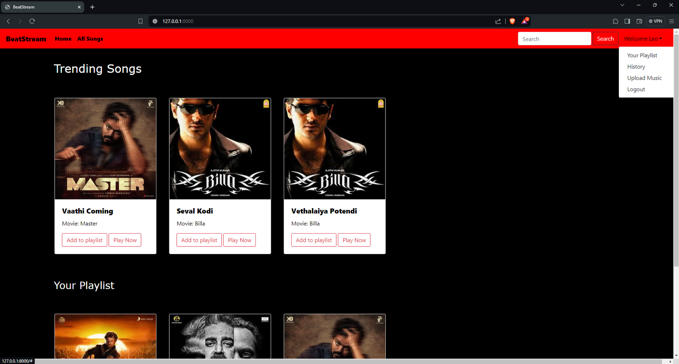
Next Gen Employability Program
Homepage

Slide 10
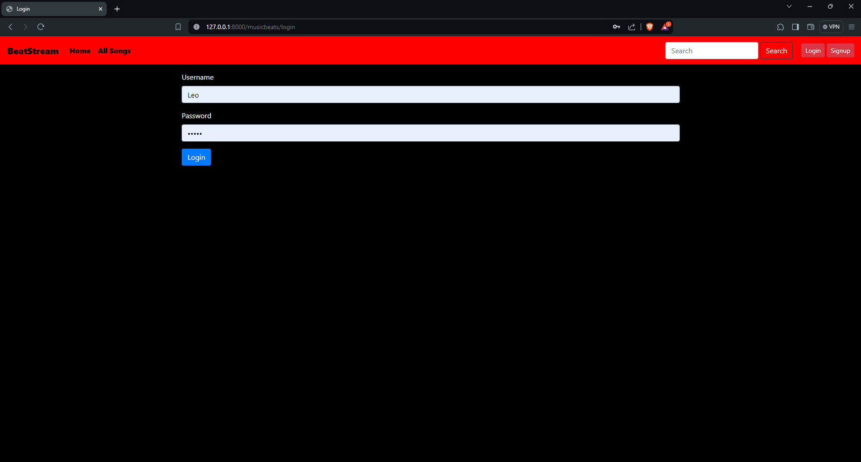
Next Gen Employability Program
Login Page

Slide 11
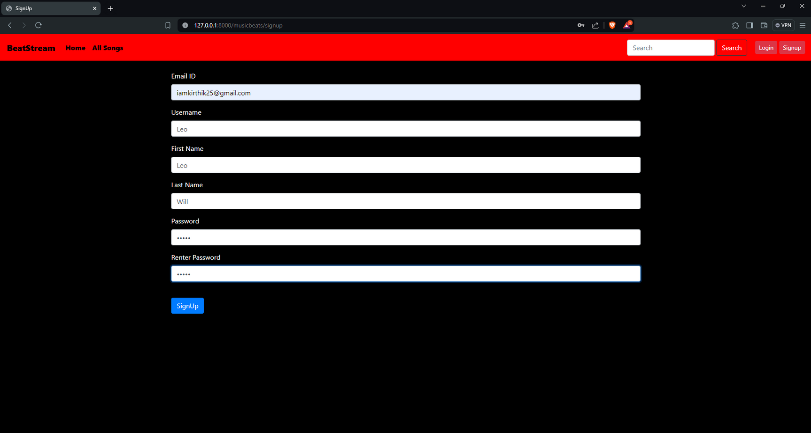
Next Gen Employability Program
Signup Page

Slide 12
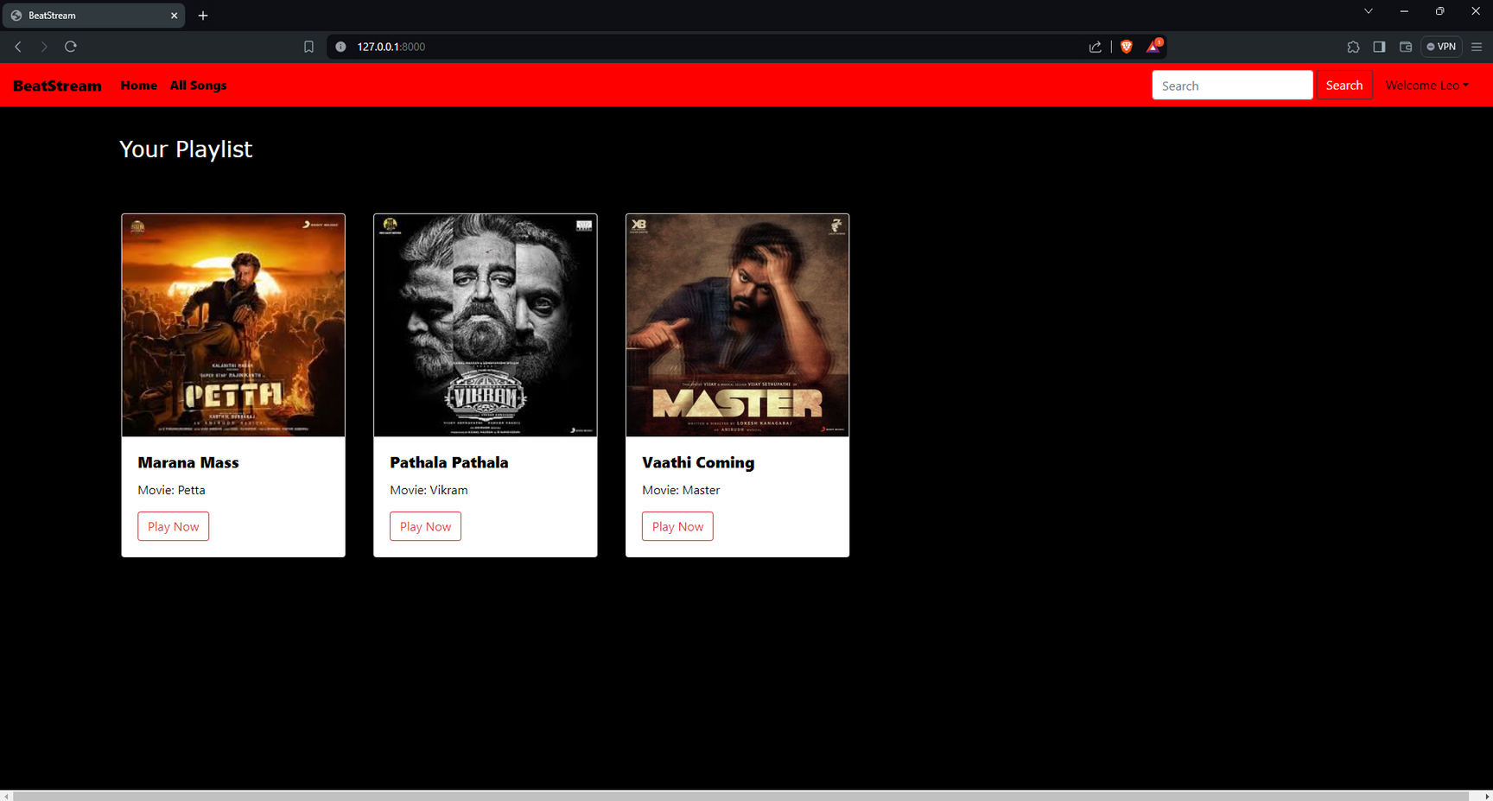
Next Gen Employability Program
My Playlist Page

Slide 13
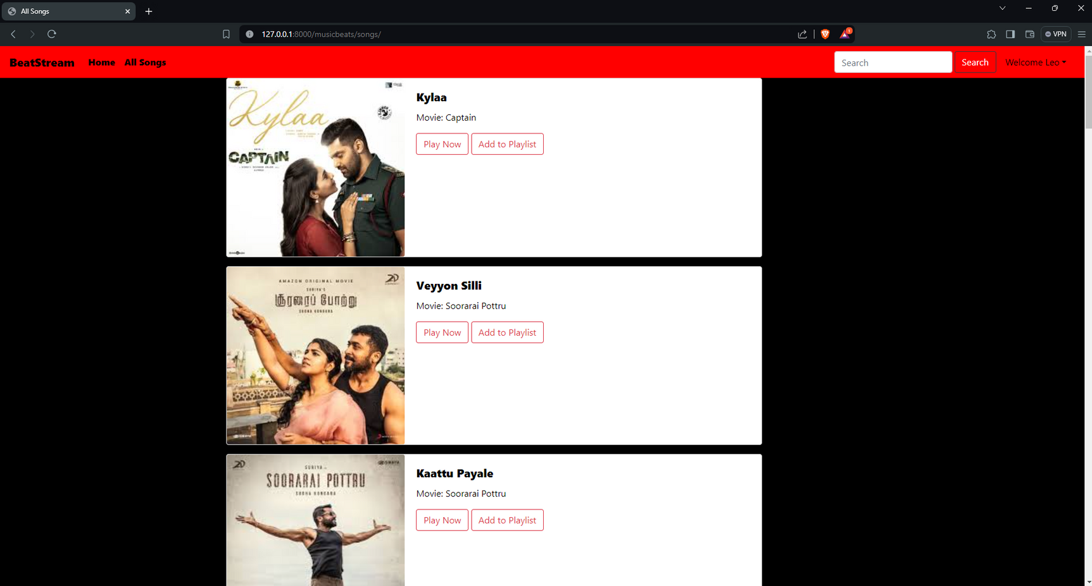
Next Gen Employability Program
All Songs Page

Slide 14
Next Gen Employability Program
Future Enhancements:
As our Music Web Application using Django Framework evolves, there are numerous exciting enhancements we can implement to enrich the user experience, expand functionality, and stay ahead of industry trends. These future enhancements will not only attract new users but also retain existing ones by offering novel features and improved usability. Let's explore some of these enhancements:
Future Enhancements:
Advanced Recommendation System
Social Features Enhancement
User-generated Content
Multimedia Content Support
Enhanced User Experience
Integration with External Services
Continuous Performance Optimization
From advanced recommendation systems to enhanced social features and multimedia content support, these upgrades will cater to the evolving needs and preferences of our users. By embracing user-generated content and integrating with external services, we aim to foster community engagement and expand our music library. Furthermore, prioritizing accessibility and continuous performance optimization ensures a seamless and inclusive experience for all users. With these enhancements, we're poised to solidify our position as a leading platform for music discovery and enjoyment.

Slide 15
Next Gen Employability Program
Conclusion
In conclusion, our Music Web Application built on the Django framework stands as a testament to the seamless integration of front-end and back-end technologies to deliver an immersive user experience. Through the utilization of HTML, CSS, JavaScript, and Bootstrap on the front end, coupled with Python, Django, and SQL on the back end, we have created a robust platform for music enthusiasts to explore, discover, and engage with their favorite tunes.
This project showcases the power and versatility of Django in handling complex web applications, offering features such as user authentication, music library management, personalized recommendations, and social integration. By leveraging SQL for efficient data storage and retrieval, we ensure scalability and performance as our user base grows.
Moving forward, our Music Web Application serves as a foundation for further enhancements and innovations, including advanced recommendation systems, social features enhancement, and multimedia content support. With a commitment to continuous improvement and user satisfaction, we aim to solidify our position as a premier destination for music discovery and enjoyment.

Slide 16
Next Gen Employability Program
Thank You!
Notes:
Thank You !!

